Slide 1

CSS
Lesson 1

Slide 2
What is CSS?
CSS – Cascading Style Sheets
Styles define how to display HTML elements
Styles were added to HTML 4.0 to solve a problem
External Style Sheets can save a lot of work
External Style Sheets are stored in CSS files

Slide 3
Three Ways To Insert CSS
External style sheet
<head>
<link rel="stylesheet" type="text/css" href="mystyle.css">
</head>
Internal style sheet
Inline styles
<style>
p
{
text-align:center;
color:red;
}
</style>
</head>
<p style="color:sienna;margin-left:20px">This is a paragraph. </p>

Slide 4
Multiple Styles Will Cascade into One
Browser default
External style sheet
Internal style sheet (in the head section)
Inline style (inside an HTML element)

Slide 5
CSS Syntax
Selector
Declaration
Declaration
p
{ {color:blue; font-size:15px}
Property
Value
Property
Value

Slide 6
CSS Comments
/*This is a comment*/
p
{
text-align:center;
/*This is another comment*/
color:black;
font-family:arial;
}
<!DOCTYPE html>
<html>
<head>
<style>
#para1
{
text-align:center;
color:red;
}
</style>
</head>
<body>
<p id="para1">Hello World! </p>
<p>This paragraph is not affected by the style. </p>
</body>
</html>
Id and Class

Slide 7
Id and Class
<style>
p.center
{
text-align:center;
}
</style>
<!DOCTYPE html>
<html>
<head>
<style>
.center
{
text-align:center;
}
</style>
</head>
<body>
<h1 class="center">Center-aligned heading</h1>
<p class="center">Center-aligned paragraph.</p>
</body>
</html>
<h1 class="center">This heading will not be affected</h1>
<p class="center">This paragraph will be center-aligned. </p>

Slide 8
Styling Backgrounds
background-color
background-image
background-repeat
background-attachment
background-position
Background-color
HEX value - like "#ff0000"
RGB value - like "rgb(255,0,0)"
color name - like "red"

Slide 9
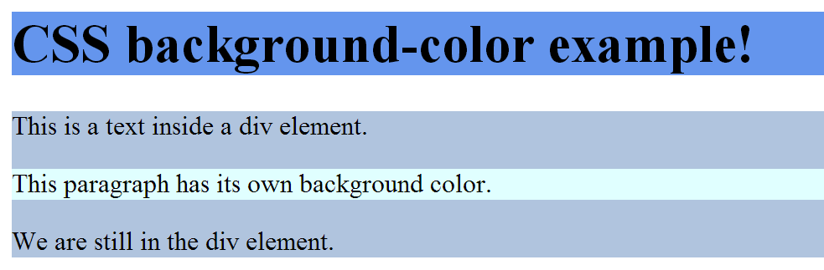
Styling Backgrounds
Background-color
<head>
<style>
h1{background-color:#6495ed; }
p{ background-color:#e0ffff; }
div{background-color:#b0c4de;}
</style>
</head>
<body>
<h1> CSS background-color example! </h1>
<div>
This is a text inside a div element.
<p> This paragraph has its own background color. </p>
We are still in the div element.
</div>
</body>

Slide 10
Styling Backgrounds
Background Image
<head>
<style>
body {background-image:url("image.jpg");} </style>
</head>
<body>
<h1> CSS background Image example! </h1>
</body>

Slide 11
Styling Backgrounds
Background Image Repeat
Value | Description
repeat | The background image will be repeated both vertically and horizontally. This is default
repeat-x | The background image will be repeated only horizontally
repeat-y | The background image will be repeated only vertically
no-repeat | The background-image will not be repeated
inherit | Specifies that the setting of the background-repeat property should be inherited from the parent element
background-repeat:no-repeat;
background-repeat:repeat-x;
background-repeat:repeat-y;

Slide 12
Styling Backgrounds
Background Position
Value | Description
left top left center left bottom right top right center right bottom center top center center center bottom | If you only specify one keyword, the other value will be "center"
x% y% | The first value is the horizontal position and the second value is the vertical. The top left corner is 0% 0%. The right bottom corner is 100% 100%. If you only specify one value, the other value will be 50%. . Default value is: 0% 0%
background-position:left top;
background- position :50% 45%;

Slide 13
Styling Backgrounds
Background Attachment
background-attachment:fixed;
background-attachment:scroll;

Slide 14
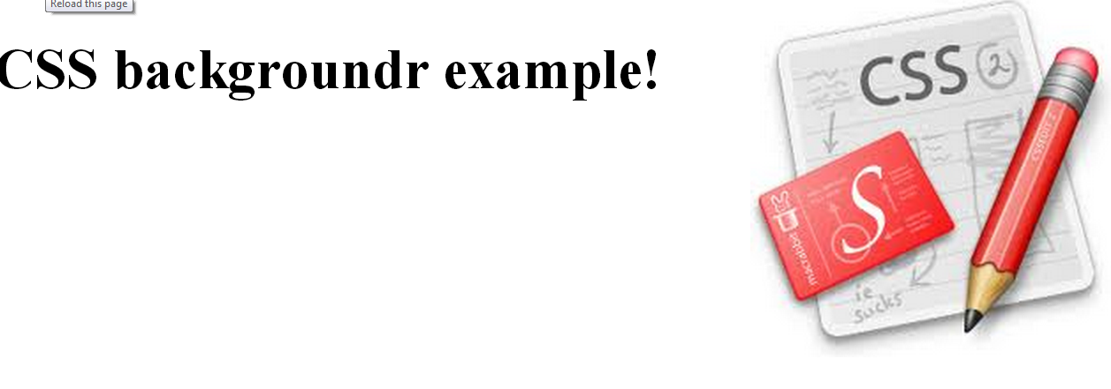
Styling Backgrounds
Background
body
{
background: #ffffff url('02.jpg') no-repeat right top;
}

Slide 15
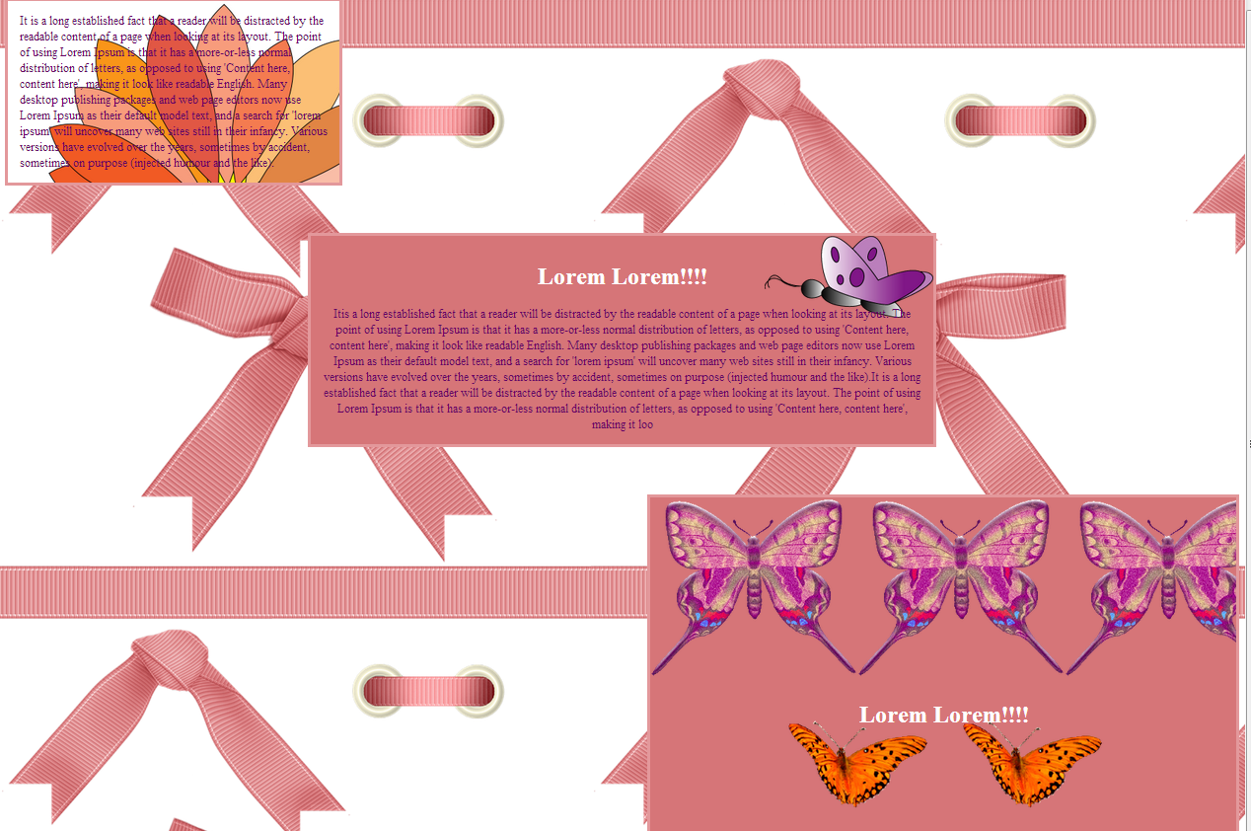
Task1:

